Slide 1
Bayesian Inference

Slide 2
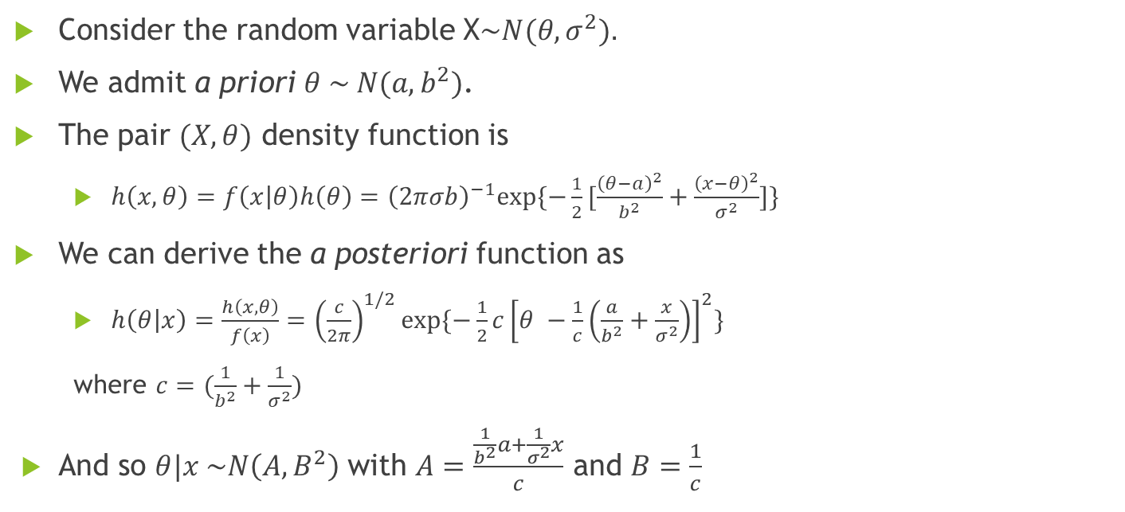
Bayesian Inference for Normal Conjugate Families
Consider the random variable X$\sim N(θ, σ^{2}).$
We admit a priori $θ \sim N(a, b^{2})$.
The pair $(X, θ)$ density function is
$h\left(x, θ\right)=f\left(x | θ\right)h\left(θ\right)={\left(2πσb\right)}^{−1}exp⁡\{−\frac{1}{2}[\frac{{\left(θ−a\right)}^{2}}{b^{2}}+\frac{{\left(x−θ\right)}^{2}}{σ^{2}}]\}$
We can derive the a posteriori function as
$h\left(θ | x\right)=\frac{h\left(x,θ\right)}{f\left(x\right)}={\left(\frac{c}{2π}\right)}^{1/2}exp⁡\{−\frac{1}{2}c{\left[θ −\frac{1}{c}\left(\frac{a}{b^{2}}+\frac{x}{σ^{2}}\right)\right]}^{2}\}$
where $c=(\frac{1}{b^{2}}+\frac{1}{σ^{2}})$
And so $θ|x \sim N\left(A,B^{2}\right)$ with $A=\frac{\frac{1}{b^{2}}a+\frac{1}{σ^{2}}x}{c}$ and $B=\frac{1}{c}$

Slide 3
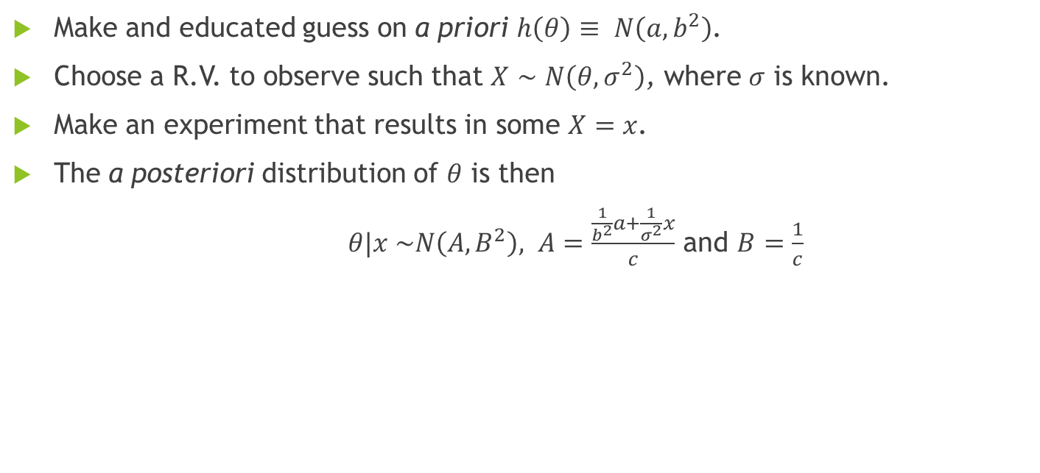
General Procedure
Make and educated guess on a priori $h\left(θ\right)≡ N\left(a, b^{2}\right)$.
Choose a R.V. to observe such that $X∼N\left(θ, σ^{2}\right)$, where $σ$ is known.
Make an experiment that results in some $X=x$.
The a posteriori distribution of $θ$ is then
$θ|x \sim N\left(A,B^{2}\right),$ $A=\frac{\frac{1}{b^{2}}a+\frac{1}{σ^{2}}x}{c}$ and $B=\frac{1}{c}$

Slide 4
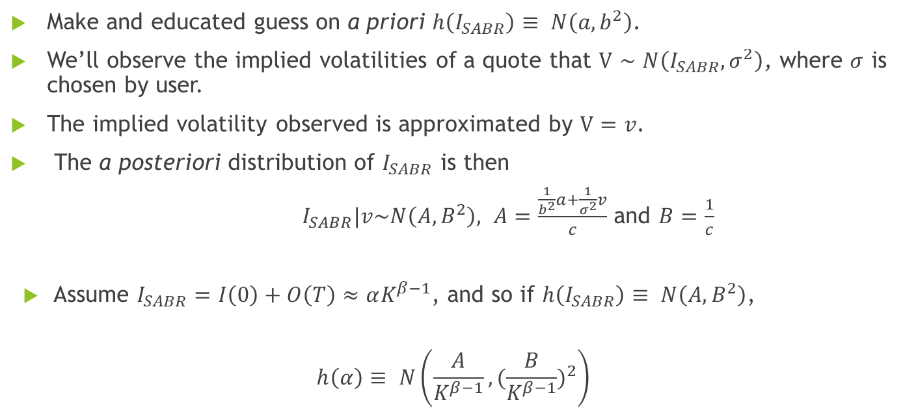
Bayesian Inference on Alpha
Make and educated guess on a priori $h\left(I_{SABR}\right)≡ N\left(a, b^{2}\right)$.
We’ll observe the implied volatilities of a quote that $V∼N\left(I_{SABR}, σ^{2}\right)$, where $σ$ is chosen by user.
The implied volatility observed is approximated by $V=v$.
The a posteriori distribution of $I_{SABR}$ is then
$I_{SABR}|v\sim N\left(A,B^{2}\right),$ $A=\frac{\frac{1}{b^{2}}a+\frac{1}{σ^{2}}v}{c}$ and $B=\frac{1}{c}$
Assume $I_{SABR}=I\left(0\right)+O\left(T\right)≈αK^{β−1}$, and so if $h\left(I_{SABR}\right)≡ N\left(A, B^{2}\right)$,
$$h\left(α\right)≡ N\left(\frac{A}{K^{β−1}}, {(\frac{B}{K^{β−1}})}^{2}\right)$$

Slide 5
Bayesian Inference
Get a priori distribution of alpha by fitting 40 quotes (20 sets of 20)
New quote + 19 previous: bayesian inference
Bayesian Inference => alpha posteriori distribution := alpha priori distribution
Repeat 2. & 3. for however many new quotes you have

Slide 6
Bayesian Inference
New observation can be:
Implied volatility of new quote (Bayesian Inference)
Alpha result of a LMA fitting to new quote (Bayesian Inference + LMA)

Slide 7

Outliers
Usual simulation, fit SABR;
Choose 10% of the sample at random and bump it by $+ X\sim N(0,1)$ or preset alpha;
Fit again, and analyze results.

Slide 8
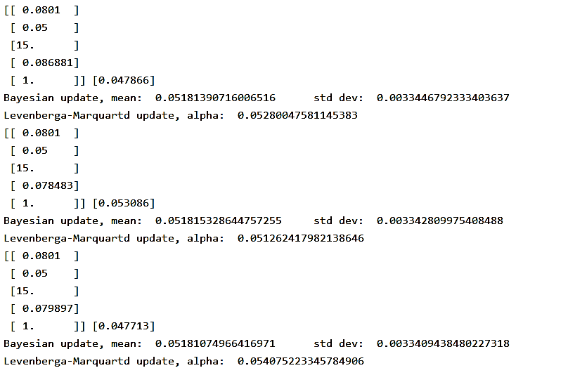
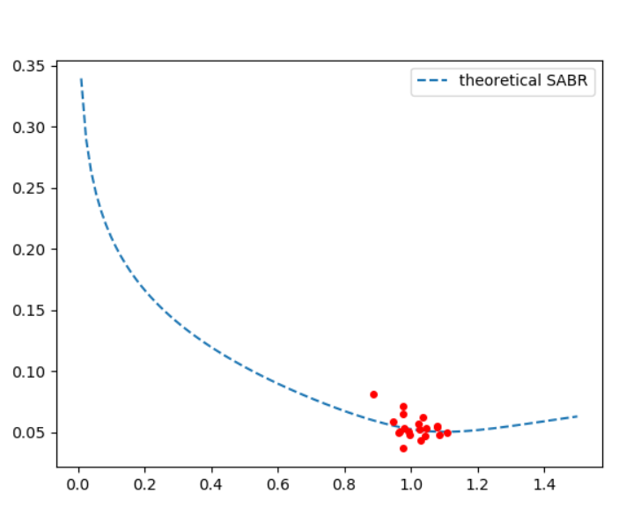

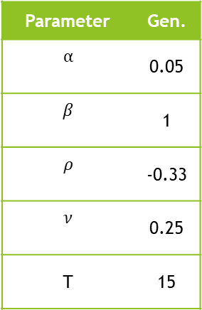

Bayesian Inference
Implied Volatility ($σ$)
Parameter | Gen.
$$α$$ | 0.05
$$β$$ | 1
$$ρ$$ | -0.33
$$ν$$ | 0.25
T | 15
Normalized Strike ($\frac{K}{f_{0}}$)

Slide 9
Bayesian Inference
This approach tends to be much more rubost and relliant on the alpha filtration
Some tests may involve stochastic alpha when generating new observations

Slide 10
Provided Data
Example:
Value Date | T | ZC | F/S | Contract | K/F | Bid/S | Ask/S
20190708-094517 | 20301218-092959 | 0.95 | 0.96 | Call(European) | 0.81 | 0.452 | 0.468
One option of each type per value date (time)
Same underlying (spot unknown)
400 quotes per day
30 days
Value Date -> Time at contract quoting
T -> Time of contract expiring
ZC -> Zero Cupon discount rate
F/S -> Foward in spot units
Contract -> Option Type
K/F -> Relative Strike
Bid/S -> Bid in spot units
Ask/S -> Ask in spot units

